Slide 1
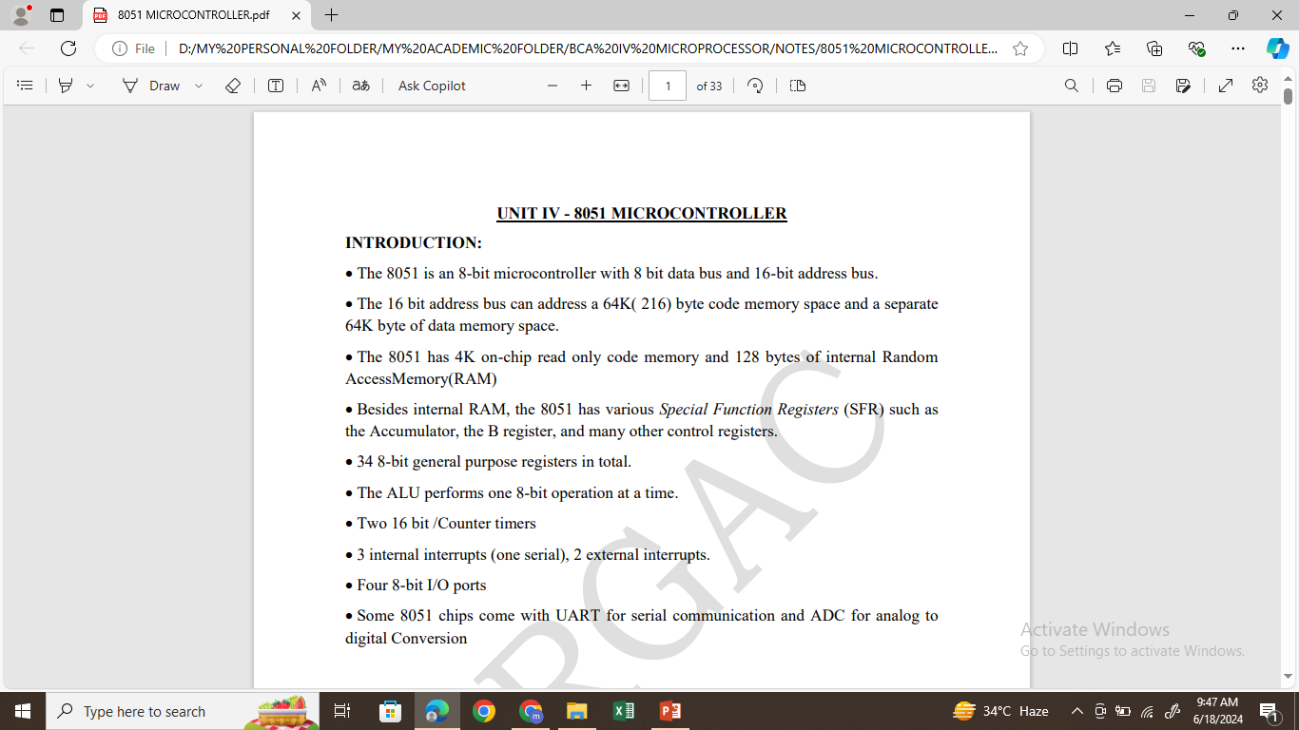
8051 MICROCONTROLLER

Slide 2
Features of 8051 Microcontroller:
It having four register banks
64K bytes on-chip programmable memory (ROM)
128 bytes on-chip data memory (RAM)
Address bus is 16-bit unidirectional
Data bus is 8-bit bidirectional
128 user defined flags
16 bit timers
32 general purpose registers each of 8-bit
8051 microcontroller offers a number of special features such as ADC, UARTs, Op-amp, etc.

Slide 3
Comparisons of Microcontroller and Microprocessor:
Microprocessor | Microcontroller
A microprocessor is a general purpose device which is called a CPU | A microcontroller is a dedicated chip which is also called single chip computer
A microprocessor do not contain on chip I/O Ports, Timers, Interrupt, Memories etc. | A microcontroller includes RAM, ROM, serial and parallel interface, timers, interrupt circuitry (in addition to CPU) in a single chip.
Microprocessors are most commonly used as the CPU in microcomputer systems. | Microcontrollers are used in small, minimum component designs performing control-oriented applications.
Microprocessor based system design is complex and expensive/Require more hardware. | Microcontroller based system design is rather simple and cost effective./require less hardware.
The Instruction set of microprocessor is complex with large number of instructions. | The instruction set of a Microcontroller is very simple with less number of instructions.
Access time for memory and i/o devices are more. | Less access time foe built in memory and i/o devices.
Less number of pins are multifunctional. | More number of pins are multifunctional.
Used in big application | Used to execute a single task within an application.

Slide 4
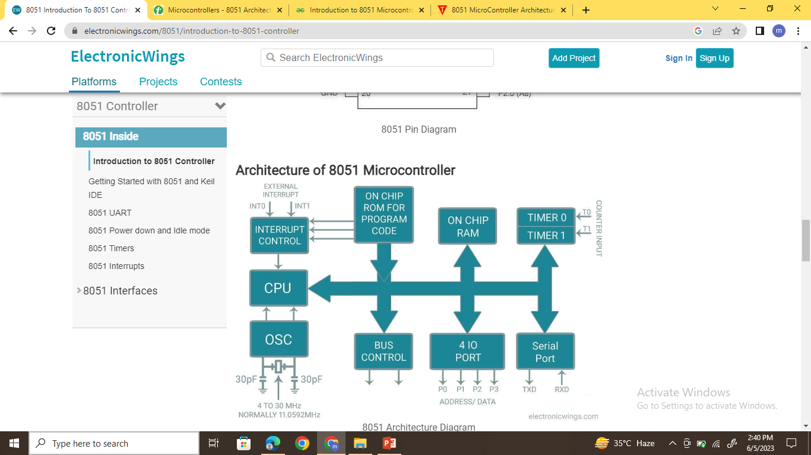
Architecture of 8051

Slide 5
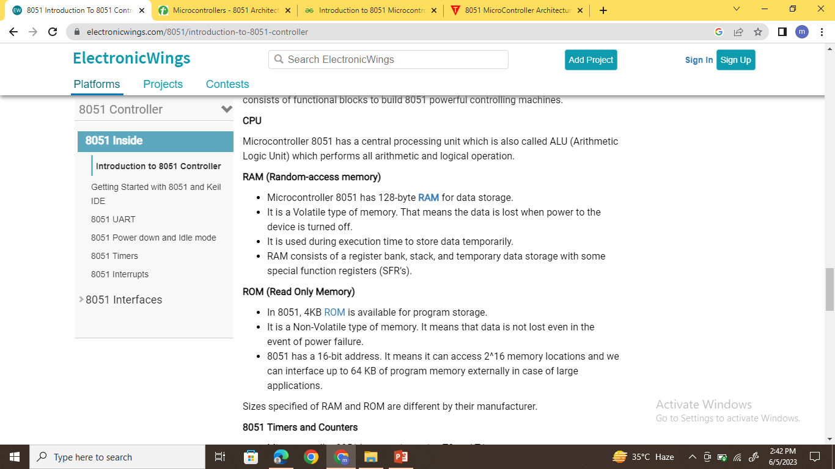

Slide 6
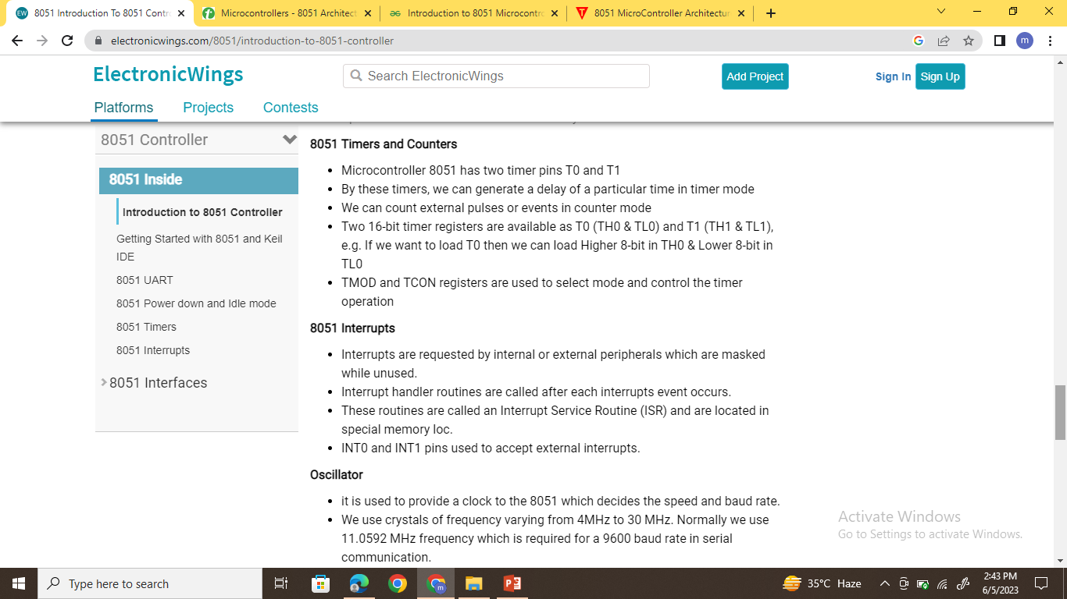

Slide 7
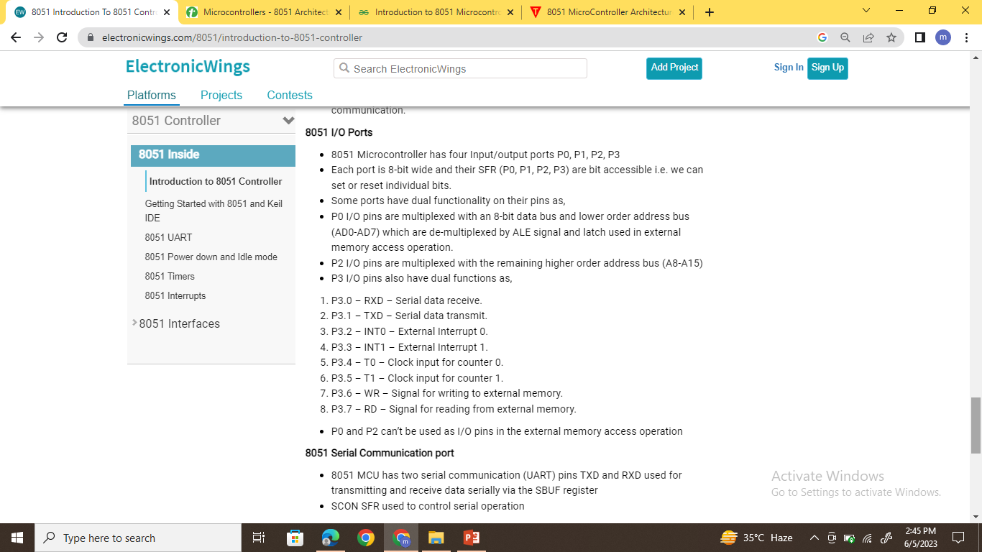

Slide 8
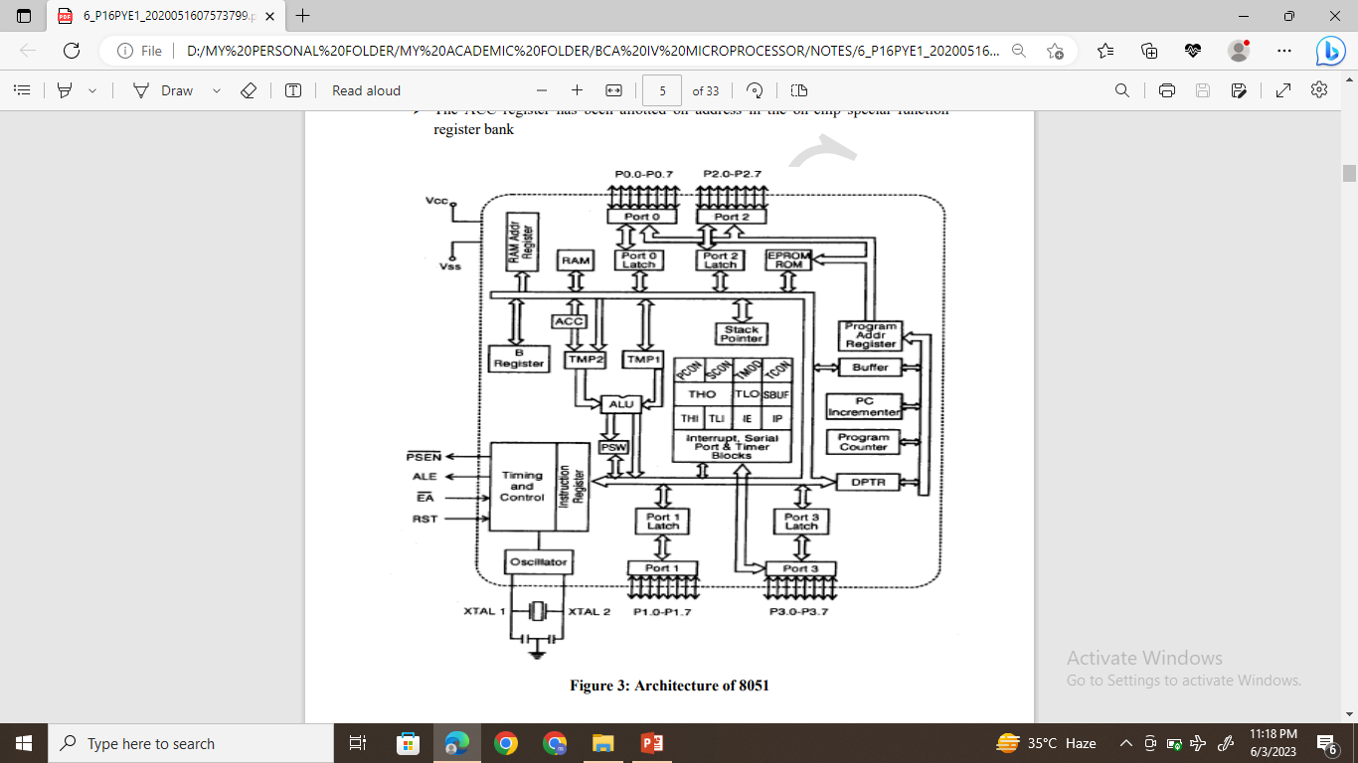
Architecture of 8051

Slide 9
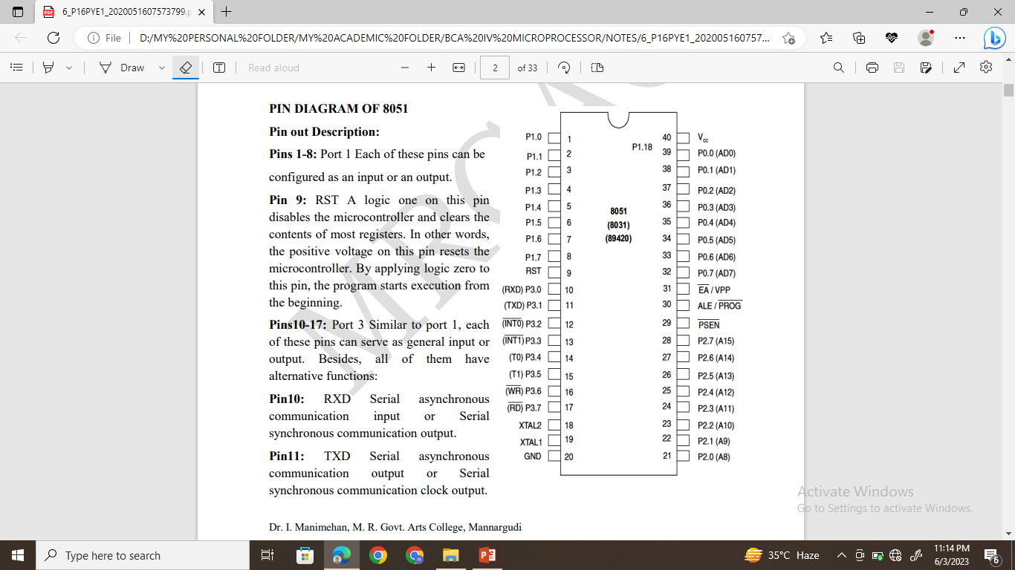
PIN DIAGRAM OF 8051

Slide 10
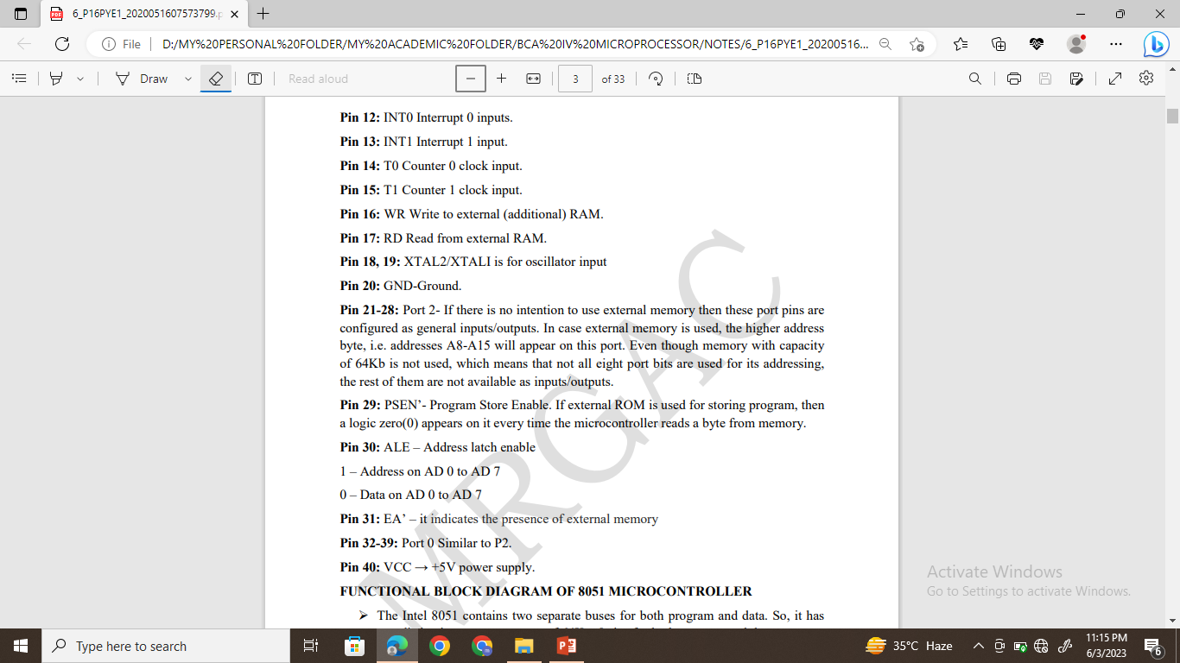

Slide 11
Application of 8051 Microcontroller
The 8051 microcontroller applications include a large amount of machines because it is used for incorporating inside a project or to assemble a machine using it.
Energy Management : In energy management system the measuring device is used for calculating the energy consumption in industrialized and domestic applications. These systems are manufactured by integrating the microcontrollers inside their architecture configuration.
Automobiles : Microcontroller 8051 is to be used for providing automobile solutions. They are largely be used in hybrid motor vehicles to control engine variations.
Touch screens: The advanced degree of microcontroller integrate the touch sensing ability within their design .Transportable devices such as cell phones, media players and gaming devices are some example of microcontroller integrated with touch screens.
Medical Devices: Microcontroller is used in various medical devices such as glucose and blood pressure measurement machine for monitoring and measuring the exact result in real-time computational environment.

Slide 12
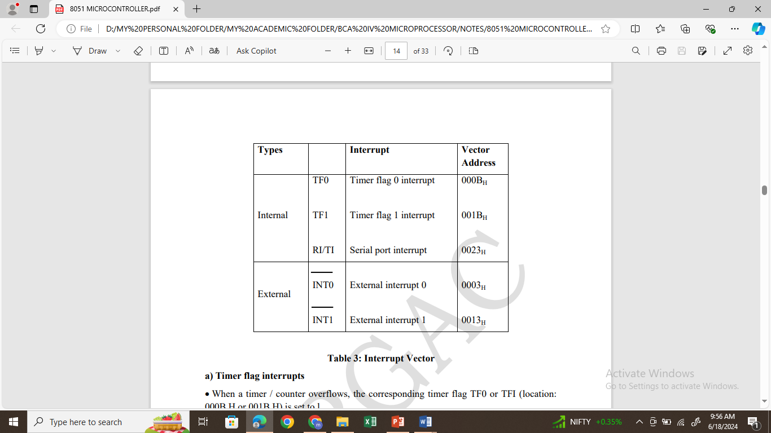
Interrupts in 8051
Five interrupts are provided in the 805l.
Three of these a regenerated by internal operations:
Timer Flag 1 & 0, and the serial port interrupt (RI or TI).
Two interrupts are triggered by external signals provided by circuitry that is connected to pin INT0’ and INT1’(port pins P3.2 and P3.3)

Slide 13
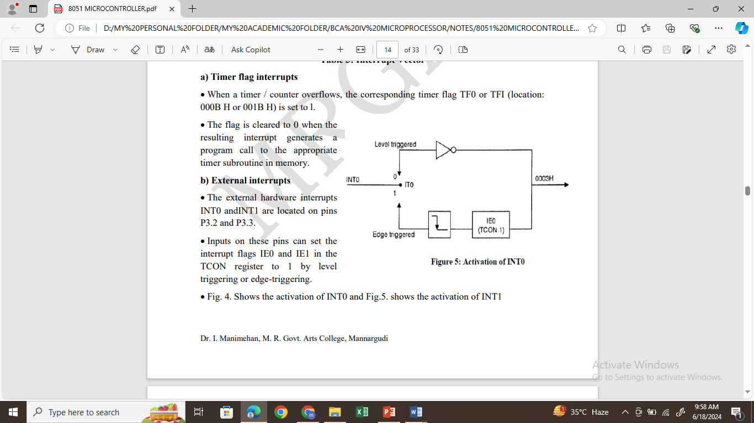

Slide 14
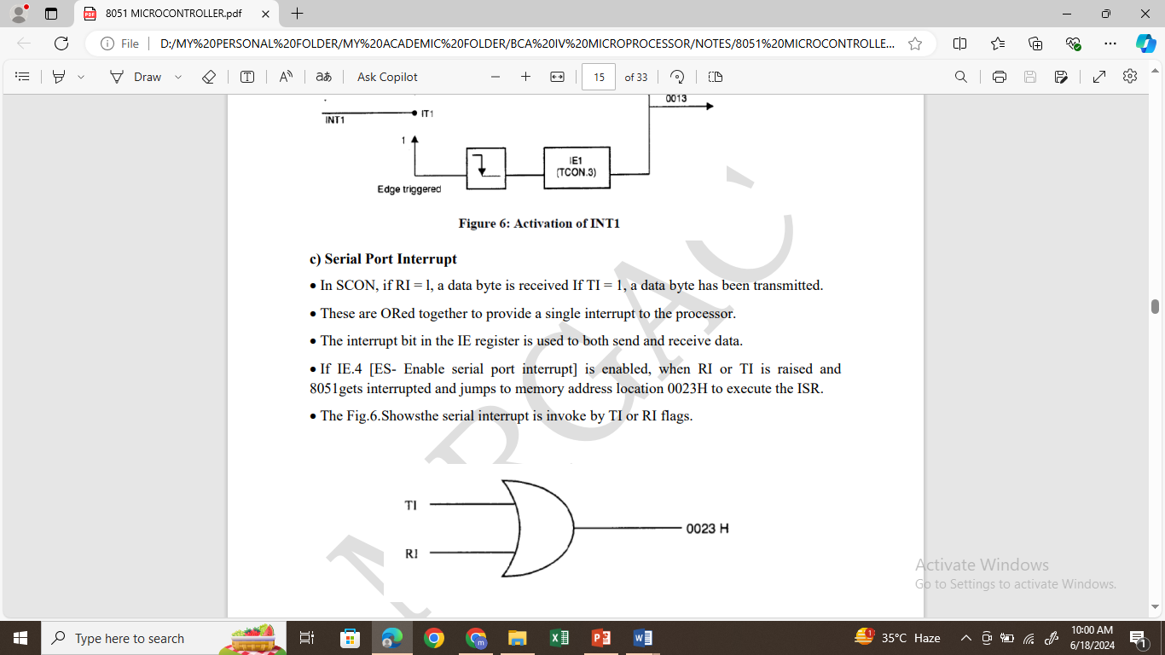

Slide 15
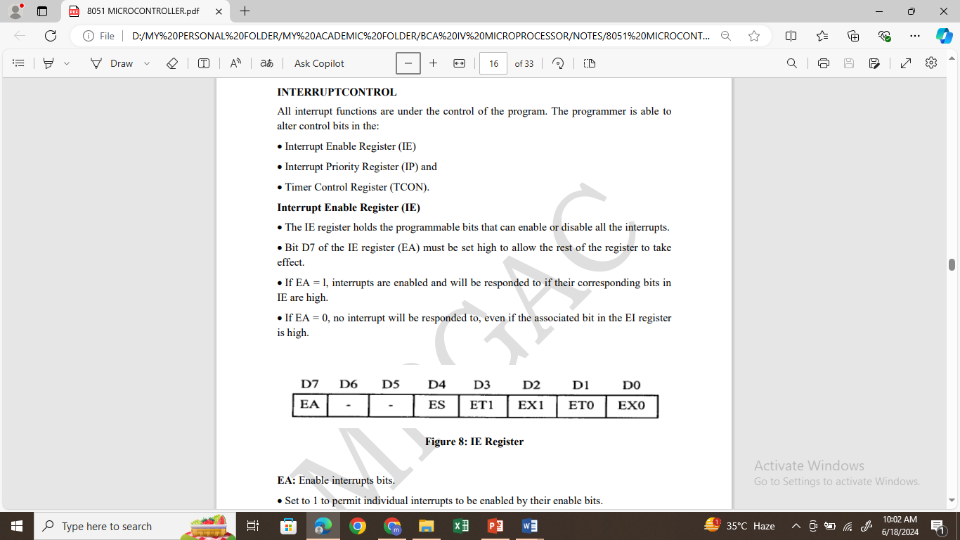

Slide 16
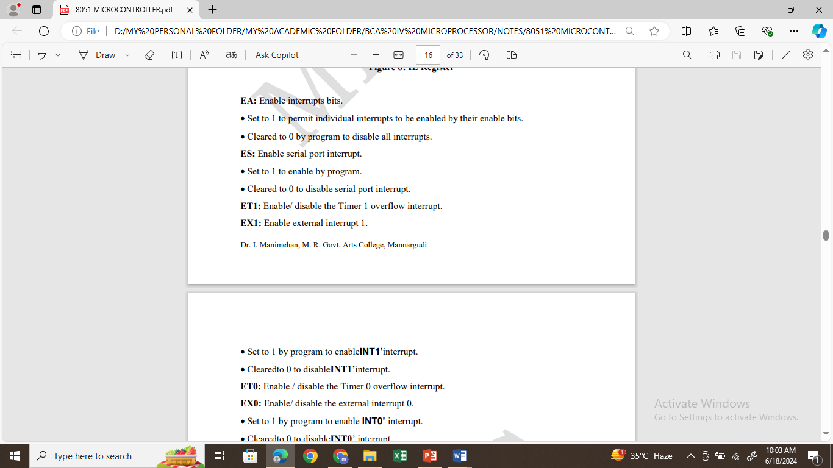
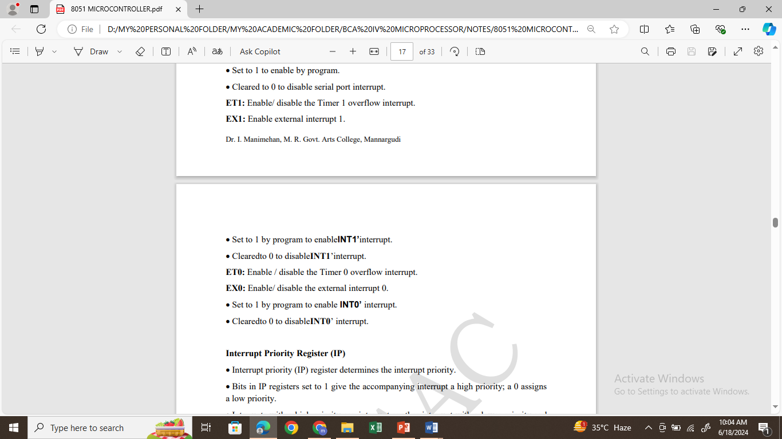

Slide 17
